Slide 1
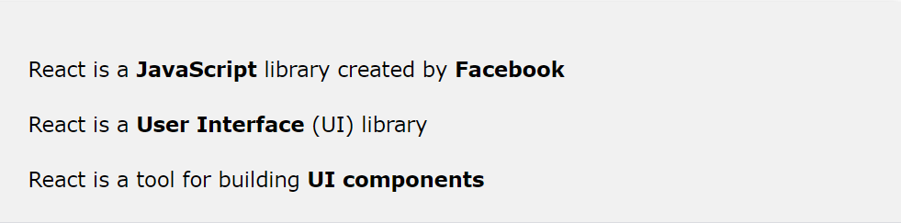
Create React App Generation
What is a React App?

Slide 2
Create React App Generation
Install Node JS in local PC

Slide 3
Create React App Generation
Download Node JS https://nodejs.org/en/download/

Slide 4
Create React App Generation
Install Node JS and verify with power shell
How to install Create React App?
Refer to create react app generation.doc

Slide 5
Create React App Generation
Create and Run React App without a Container

Slide 6
Create React App Generation
Goto c:/app
Run “npx create-react-app frontend”

Slide 7
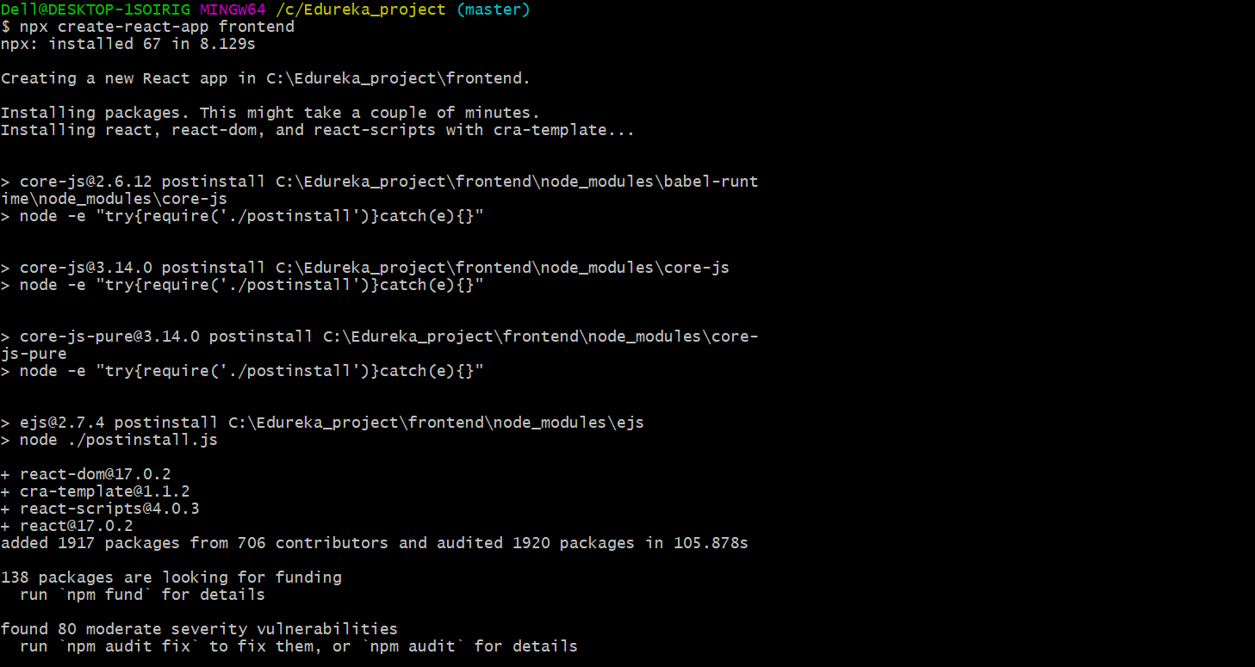
Create React App Generation
Goto c:/edureka_project (using a Git Bash)
Run “npx create-react-app frontend”

Slide 8
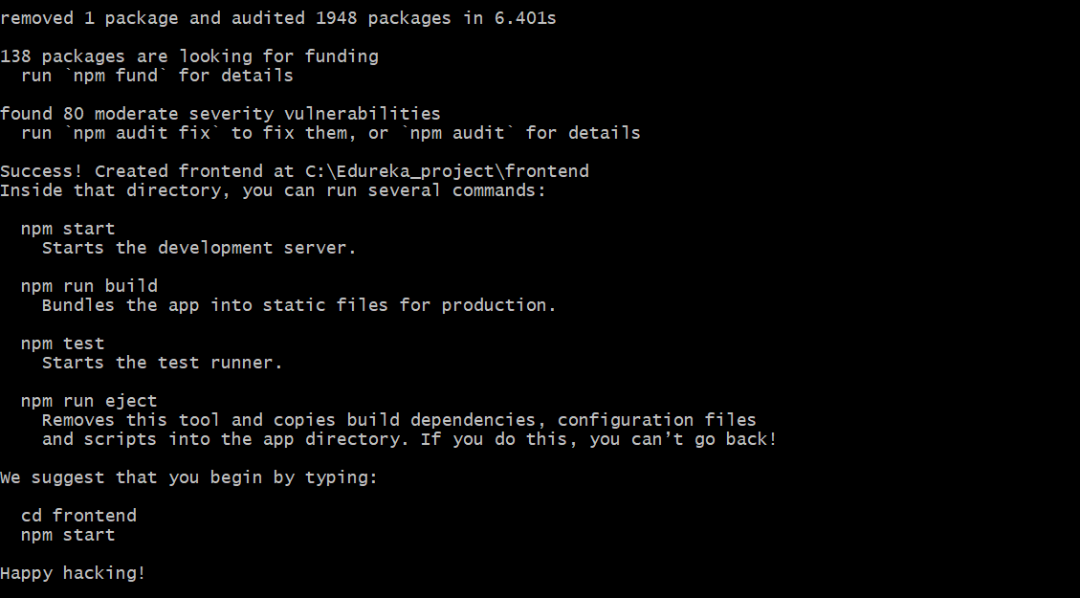
Create React App Generation
Frontend created successfully

Slide 9
Create React App Generation
Goto frontend and type “npm start”
Start up the development server

Slide 10
Create React App Generation
Goto frontend and type “npm start”

Slide 11
Create React App Generation
React App (frontend) is generated
Browser will auto-pop up with React App (auto-mapped to port 3000)

Slide 12
Create React App Generation
Notes
Type Ctrl C to terminate React App (frontend)

